Slide 1
Hive data types

Slide 2
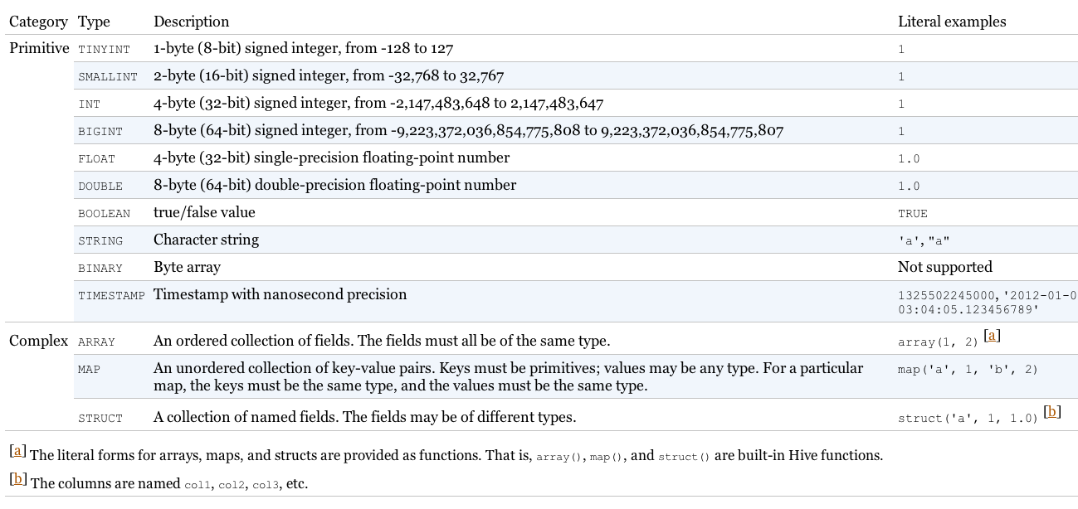
Data Types

Slide 3
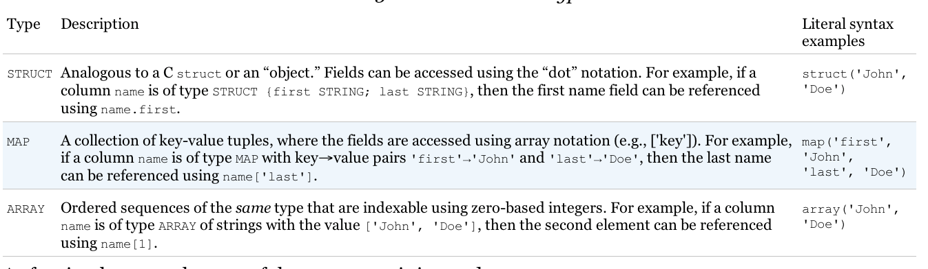
Complex Data Types
Most relational databases don’t support complex data types since they tend to break normal form.
For example structures in relational DB are usually captured in separate tables with foreign keys, etc.
Breaking normal form results in data duplication
More disk consumption
Data inconsistencies

Slide 4
Normal Form Example
Student ID | Student First name | Student Last name | Email
Subject code | Subject Name | Lecturer Name | Semester
Student ID | Subject Code
The above is an example of a schema which conforms to normal form.
Typically relational databases use the above schema since it means there are no data duplication.

Slide 5
Complex Data Types
For Big Data
Data are normally not updated
We get better performance by sacrificing normal form
Less need to join tables
Embedding collections inside records minimizes seeks.
Navigating each foreign key relation requires seeking across disk and/or getting data from other nodes.
Can directly use data files that are not in normal form without needing to first load the data into the database.

Slide 6
Complex Data Type Example
Subject code | Subject Name | Lecturer Name | Semester | Array of students
CSE3BDC | Big data management on the cloud | Zhen He | 1 | [<9198, Peter, Smith, p.smith@gmail.com>, <9291, John, Wilson, j.wilson@gmail.com>, etc.]
We can imagine the above is from a file that contains the class list of students for each subject in the university.
Hive does not need to touch the file but instead just needs to impose the above schema on the file as the file is read from the disk.
For example when a student changes his/her email address the above schema causes a problem since all entries that contain that student need to be updated. However, typically when we doing data analytics (typical use for Hive and MapReduce) data is never updated.

Slide 7
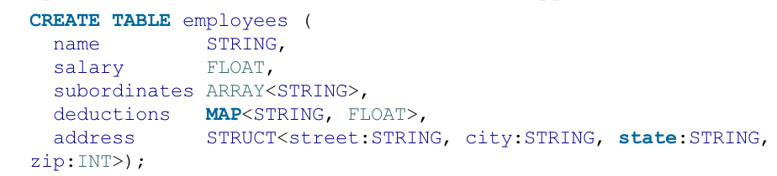
Complex Data Types
We can treat the name as a primary key
Subordinates would reference another record in the table.
Deductions is a map that holds a key-value pair
Every deduction has a name (e.g. “Federal Taxes”) and the percentage of deduction (e.g. 10).
For traditional DBs this map would be stored in a separate table.
Address is stored as a separate struct.
Java syntax conventions for generics are followed for the collection types.
E.g. MAP<STRING, FLOAT>, ARRAY<STRING>

